Slide 1
Wallace Tree Multiplier

Slide 2
SOFTWARE REQUIRED
Cadence NC Launch Tool
Cadence Genus Tool
Modelsim 6.5

Slide 3
PROCEDURE
Open the terminal and gedit window.
Code the verilog design and test bench for the given designs and save it.
Open NCLaunch tool and compile the design and test bench.
Choose test bench from work.lib and elaborate it.
Choose test bench from snapshots and simulate it.
Open the waveform window and Run the simulation.

Slide 4
Observe and Capture the waveform.
Save the design inside rtl folder for synthesis.
Open the terminal inside syn folder and launch the genus tool.
Type the all the commands that needed for synthesis to generate netlist, sdc, power, timing, area reports.
Analyse the generated reports from syn folder and tabulate the results.

Slide 5
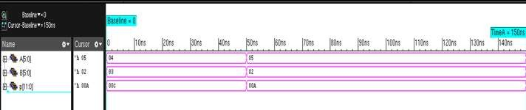
WAVEFORM:

Slide 6
SYNTHESIS REPORT:
POWER REPORT:
am |  | CELLS 68 | LEAKAGE POWER(nW) 3511.511 | DYNAMIC POWER(nW) 24308.438 | TOTAL POWER(nW) 27819.949
 | f9 | 3 | 88.570 | 325.220 | 413.790
 | h1 | 1 | 86.962 | 219.390 | 306.352
 | h2 | 1 | 86.962 | 290.435 | 377.397
 | h3 | 1 | 86.962 | 339.324 | 426.286
 | h4 | 1 | 86.962 | 377.523 | 464.485

Slide 7
h5 | 1 | 86.962 | 610.606 | 697.568
h6 | 1 | 86.962 | 521.347 | 608.309
f1 | 1 | 84.476 | 422.719 | 507.196
f2 | 1 | 84.476 | 312.222 | 396.699
f3 | 1 | 84.476 | 429.833 | 514.310
f4 | 1 | 84.476 | 504.324 | 588.800
f5 | 1 | 84.476 | 432.480 | 516.956
f6 | 1 | 84.476 | 557.621 | 642.098
f7 | 1 | 84.476 | 585.619 | 670.095
f8 | 1 | 84.476 | 538.098 | 622.574
f10 | 1 | 84.476 | 1031.703 | 1116.179
f11 | 1 | 84.476 | 1167.681 | 1252.157
f12 | 1 | 84.476 | 891.084 | 975.560
f13 | 1 | 84.476 | 741.879 | 826.355
f14 | 1 | 84.476 | 810.284 | 894.760
f15 | 1 | 84.476 | 907.304 | 991.780
f16 | 1 | 84.476 | 879.668 | 964.144
f17 | 1 | 84.476 | 763.263 | 847.740
f18 | 1 | 84.476 | 819.302 | 903.778
f19 | 1 | 84.476 | 590.392 | 674.868
f20 | 1 | 84.476 | 854.831 | 939.307
f21 | 1 | 84.476 | 909.692 | 994.169
f22 | 1 | 84.476 | 866.770 | 951.246
f23 | 1 | 84.476 | 716.714 | 801.190
f24 | 1 | 67.041 | 151.052 | 218.093

Slide 8
AREA REPORT:
Instance | Module | Cell | Count | Cell Area | Net Area | Total Area | Wireload
am |  |  | 68 | 704.674 | 0.000 | 704.674 | <none> | (D)
f24 | fulladder_23 |  | 1 | 19.679 | 0.000 | 19.679 | <none> | (D)
f23 | fulladder_22 |  | 1 | 19.679 | 0.000 | 19.679 | <none> | (D)
f22 | fulladder_21 |  | 1 | 19.679 | 0.000 | 19.679 | <none> | (D)
f21 | fulladder_20 |  | 1 | 19.679 | 0.000 | 19.679 | <none> | (D)
f20 | fulladder_19 |  | 1 | 19.679 | 0.000 | 19.679 | <none> | (D)
f19 | fulladder_18 |  | 1 | 19.679 | 0.000 | 19.679 | <none> | (D)
f18 | fulladder_17 |  | 1 | 19.679 | 0.000 | 19.679 | <none> | (D)
f17 | fulladder_16 |  | 1 | 19.679 | 0.000 | 19.679 | <none> | (D)
f16 | fulladder_15 |  | 1 | 19.679 | 0.000 | 19.679 | <none> | (D)
f15 | fulladder_14 |  | 1 | 19.679 | 0.000 | 19.679 | <none> | (D)
f14 | fulladder_13 |  | 1 | 19.679 | 0.000 | 19.679 | <none> | (D)
f13 | fulladder_12 |  | 1 | 19.679 | 0.000 | 19.679 | <none> | (D)
f12 | fulladder_11 |  | 1 | 19.679 | 0.000 | 19.679 | <none> | (D)
f11 | fulladder_10 |  | 1 | 19.679 | 0.000 | 19.679 | <none> | (D)
f10 | fulladder_9 |  | 1 | 19.679 | 0.000 | 19.679 | <none> | (D)
f8 | fulladder_7 |  | 1 | 19.679 | 0.000 | 19.679 | <none> | (D)
f7 | fulladder_6 |  | 1 | 19.679 | 0.000 | 19.679 | <none> | (D)
f6 | fulladder_5 |  | 1 | 19.679 | 0.000 | 19.679 | <none> | (D)
f5 | fulladder_4 |  | 1 | 19.679 | 0.000 | 19.679 | <none> | (D)
f4 | fulladder_3 |  | 1 | 19.679 | 0.000 | 19.679 | <none> | (D)
f3 | fulladder_2 |  | 1 | 19.679 | 0.000 | 19.679 | <none> | (D)
f2 | fulladder_1 |  | 1 | 19.679 | 0.000 | 19.679 | <none> | (D)
f1 | fulladder |  | 1 | 19.679 | 0.000 | 19.679 | <none> | (D)
f9 | fulladder_8 |  | 3 | 15.895 | 0.000 | 15.895 | <none> | (D)
h6 | halfadder_5 |  | 1 | 12.110 | 0.000 | 12.110 | <none> | (D)
h5 | halfadder_4 |  | 1 | 12.110 | 0.000 | 12.110 | <none> | (D)
h4 | halfadder_3 |  | 1 | 12.110 | 0.000 | 12.110 | <none> | (D)
h3 | halfadder_2 | 1 | 12.110 | 0.000 | 12.110 | <none> | (D)
h2 | halfadder_1 | 1 | 12.110 | 0.000 | 12.110 | <none> | (D)
h1 | halfadder | 1 | 12.110 | 0.000 | 12.110 | <none> | (D)
(D) = wireload is default in technology library

Slide 9
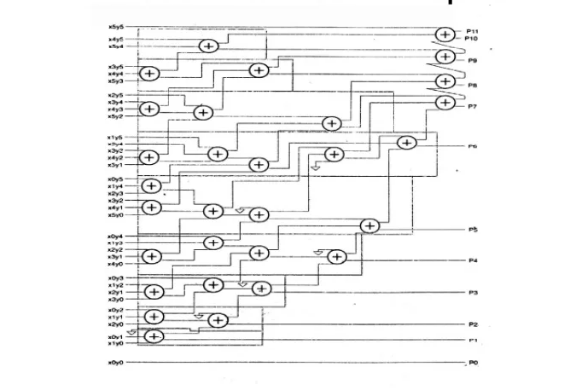
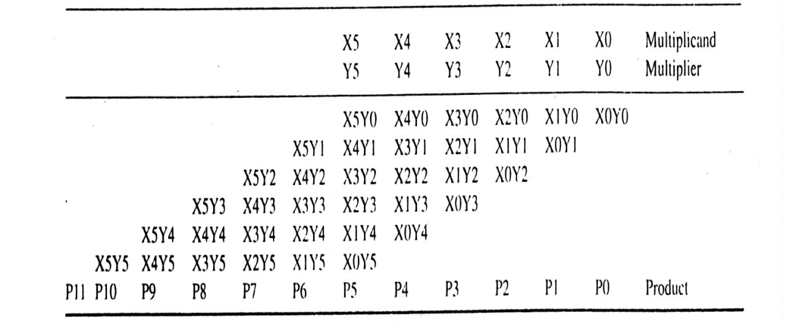
6x6 Wallace Tree Multiplier

Slide 10
WALLACE TREE MULTIPLIER:
`timescale 1ns/1ns module wm(A,B,p);
input [5:0]A,B; output [11:0]p; wire [35:0]w;
wire [26:1]s,c;
and a1(w[0],A[0],B[0]);
and a2(w[1],A[1],B[0]);
and a3(w[2],A[2],B[0]);
and a4(w[3],A[3],B[0]);
and a5(w[4],A[4],B[0]);
and a6(w[5],A[5],B[0]);
and a7(w[6],A[0],B[1]);
and a8(w[7],A[1],B[1]);
and a9(w[8],A[2],B[1]);
and a10(w[9],A[3],B[1]);
and a11(w[10],A[4],B[1]);
and a12(w[11],A[5],B[1]);
and a13(w[12],A[0],B[2]);
and a14(w[13],A[1],B[2]);
and a15(w[14],A[2],B[2]);
and a16(w[15],A[3],B[2]);
and a17(w[16],A[4],B[2]);
and a18(w[17],A[5],B[2]);

Slide 11
fulladder f1(s[1],c[1],w[1],w[6],1'b0);
fulladder f2(s[2],c[2],w[2],w[7],w[12]);
fulladder f3(s[3],c[3],w[3],w[8],w[13]);
fulladder f4(s[4],c[4],w[4],w[9],w[14]);
fulladder f5(s[5],c[5],w[5],w[10],w[15]);
fulladder f6(s[6],c[6],w[11],w[16],1'b0);
fulladder f7(s[7],c[7],w[19],w[24],1'b0);
fulladder f8(s[8],c[8],w[20],w[25],w[30]);
fulladder f9(s[9],c[9],w[21],w[26],w[31]);
fulladder f10(s[10],c[10],w[22],w[27],w[32]);
fulladder f11(s[11],c[11],w[23],w[28],w[33]);
fulladder f12(s[12],c[12],w[29],w[34],1'b0);
fulladder f13(s[13],c[13],c[1],s[2],1'b0);
fulladder f14(s[14],c[14],c[2],s[3],w[18]);
fulladder f15(s[15],c[15],c[3],s[4],s[7]);
fulladder f16(s[16],c[16],c[4],s[5],c[7]);
fulladder f17(s[17],c[17],c[5],s[6],c[8]);
fulladder f18(s[18],c[18],c[6],w[17],c[9]);
fulladder f19(s[19],c[19],c[13],s[14],1'b0);
and a19(w[18],A[0],B[3]);
and a20(w[19],A[1],B[3]);
and a21(w[20],A[2],B[3]);
and a22(w[21],A[3],B[3]);
and a23(w[22],A[4],B[3]);
and a24(w[23],A[5],B[3]);
and a25(w[24],A[0],B[4]);
and a26(w[25],A[1],B[4]);
and a27(w[26],A[2],B[4]);
and a28(w[27],A[3],B[4]);
and a29(w[28],A[4],B[4]);
and a30(w[29],A[5],B[4]);
and a31(w[30],A[0],B[5]);
and a32(w[31],A[1],B[5]);
and a33(w[32],A[2],B[5]);
and a34(w[33],A[3],B[5]);
and a35(w[34],A[4],B[5]);
and a36(w[35],A[5],B[5]);

Slide 12
fulladder f20(s[20],c[20],c[14],s[15],1'b0);
fulladder f21(s[21],c[21],c[15],s[16],s[8]);
fulladder f22(s[22],c[22],c[16],s[17],s[9]);
fulladder f23(s[23],c[23],c[17],s[18],s[10]);
fulladder f24(s[24],c[24],c[18],c[10],s[11]);
fulladder f25(s[25],c[25],c[11],s[12],1'b0);
fulladder f26(s[26],c[26],c[12],w[35],1'b0);
assign p[0]=w[0];
assign p[1]=s[1]; assign p[2]=s[13];
assign p[3]=s[19];
carryadder c1(p[4],p[5],p[6],p[7],
p[8],p[9],p[10],p[11],
c[26:2 0],s[26:20],c[19]);
endmodule
module fulladder(s,c,a,b,d); output s,c;
input a,b,d; wire w1,w2,w3;
halfadder ha1(w1,w2,a,b);
halfadder ha2(s,w3,w1,d); or or1(c,w3,w2);
endmodule
module halfadder(s,c,a,b);
output s,c;
input a,b;
assign s=(a^b);
assign c=(a&b);
endmodule
module carryadder(s0,s1,s2,s3,s4,s5,s6,cout,a,b,cin); output s0,s1,s2,s3,s4,s5,s6,cout;
input [6:0]a,b; input cin;
wire c1,c2,c3,c4,c5,c6; fulladder r1(s0,c1,a[0],b[0],cin);
fulladder r2(s1,c2,a[1],b[1],c1);
fulladder r3(s2,c3,a[2],b[2],c2);
fulladder r4(s3,c4,a[3],b[3],c3);
fulladder r5(s4,c5,a[4],b[4],c4);
fulladder r6(s5,c6,a[5],b[5],c5);
fulladder r7(s6,cout,a[6],b[6],c6);
endmodule

Slide 13
TEST BENCH:
`timescale 1ns/1ns
module tb_wm;
reg [5:0]A,B;
wire [11:0]p;
wm uut(.A(A),.B(B),.p(p));
initial begin A=6'd4; B=6'd3; #100 A=6'd5; B=6'd2;
#200 $finish;
end
endmodule

Slide 14
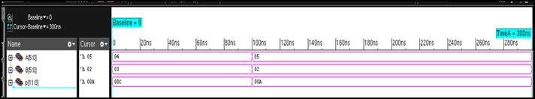
WAVEFORM:

Slide 15
SYNTHESIS REPORT:
POWER REPORT:
wm | INSTANCE |  | CELLS 117 | LEAKAGE POWER(nW) 6953.839 | DYNAMIC POWER(nW) 30500.680 | TOTAL POWER(nW) 37454.519
 | c1 |  | 21 | 1515.363 | 5938.154 | 7453.516
 | r1 |  | 3 | 216.480 | 862.277 | 1078.757
 |  | ha1 | 1 | 86.962 | 475.983 | 562.945
 |  | ha2 | 1 | 86.962 | 357.493 | 444.455
 | r2 |  | 3 | 216.480 | 905.524 | 1122.004
 |  | ha1 | 1 | 86.962 | 472.809 | 559.771
 |  | ha2 | 1 | 86.962 | 245.976 | 332.938
 | r3 |  | 3 | 216.480 | 1157.494 | 1373.974
 |  | ha1 | 1 | 86.962 | 574.079 | 661.041
 |  | ha2 | 1 | 86.962 | 430.008 | 516.970
 | r4 |  | 3 | 216.480 | 1031.651 | 1248.131
 |  | ha1 | 1 | 86.962 | 380.567 | 467.529
 |  | ha2 | 1 | 86.962 | 374.915 | 461.877

Slide 16
 | r5 |  | 3 | 216.480 | 1050.370 | 1266.850
 |  | ha1 | 1 | 86.962 | 340.915 | 427.877
 |  | ha2 | 1 | 86.962 | 436.605 | 523.567
 | r6 |  | 3 | 216.480 | 661.210 | 877.690
 |  | ha1 | 1 | 86.962 | 107.000 | 193.962
 |  | ha2 | 1 | 86.962 | 373.783 | 460.745
 | r7 |  | 3 | 216.480 | 269.629 | 486.109
 |  | ha1 | 1 | 86.962 | 53.662 | 140.624
 |  | ha2 | 1 | 86.962 | 174.156 | 261.118
 | f2 |  | 3 | 216.480 | 955.914 | 1172.394
 | ha | 1 | 1 | 86.962 | 319.565 | 406.527
 | ha | 2 | 1 | 86.962 | 452.632 | 539.594
 | f3 |  | 3 | 216.480 | 535.737 | 752.218
 | ha | 1 | 1 | 86.962 | 184.863 | 271.825
 | ha | 2 | 1 | 86.962 | 258.774 | 345.736
 | f4 |  | 3 | 216.480 | 667.827 | 884.307
 | ha | 1 | 1 | 86.962 | 242.021 | 328.983
 | ha | 2 | 1 | 86.962 | 334.227 | 421.189
 | f5 |  | 3 | 216.480 | 781.758 | 998.238
 | ha | 1 | 1 | 86.962 | 276.495 | 363.457
 | ha | 2 | 1 | 86.962 | 414.255 | 501.217
 | f8 |  | 3 | 216.480 | 798.458 | 1014.938
 | ha | 1 | 1 | 86.962 | 269.421 | 356.383
 | ha | 2 | 1 | 86.962 | 382.950 | 469.912
 | f9 |  | 3 | 216.480 | 829.178 | 1045.658
 | ha | 1 | 1 | 86.962 | 265.405 | 352.367
 | ha | 2 | 1 | 86.962 | 410.648 | 497.610
 | f10 |  | 3 | 216.480 | 924.376 | 1140.856
 | ha | 1 | 1 | 86.962 | 297.955 | 384.917
 | ha | 2 | 1 | 86.962 | 480.875 | 567.837
 | f11 |  | 3 | 216.480 | 716.116 | 932.596
 | ha | 1 | 1 | 86.962 | 241.013 | 327.975
 | ha | 2 | 1 | 86.962 | 383.843 | 470.805
 | f14 |  | 3 | 216.480 | 890.877 | 1107.357
 | ha | 1 | 1 | 86.962 | 336.571 | 423.533
 | ha | 2 | 1 | 86.962 | 369.553 | 456.515

Slide 17
f16 | 3 | 216.480 | 1005.300 | 1221.780
ha1 | 1 | 86.962 | 401.555 | 488.517
ha2 | 1 | 86.962 | 418.396 | 505.358
f17 | 3 | 216.480 | 882.336 | 1098.817
ha1 | 1 | 86.962 | 287.716 | 374.678
ha2 | 1 | 86.962 | 410.306 | 497.268
f18 | 3 | 216.480 | 420.539 | 637.020
ha1 | 1 | 86.962 | 97.991 | 184.953
ha2 | 1 | 86.962 | 230.542 | 317.504
f21 | 3 | 216.480 | 1783.043 | 1999.524
ha1 | 1 | 86.962 | 651.528 | 738.490
ha2 | 1 | 86.962 | 763.614 | 850.576
f22 | 3 | 216.480 | 1463.611 | 1680.091
ha1 | 1 | 86.962 | 512.497 | 599.459
ha2 | 1 | 86.962 | 677.530 | 764.492
f23 | 3 | 216.480 | 1541.784 | 1758.264
ha1 | 1 | 86.962 | 426.741 | 513.703
ha2 | 1 | 86.962 | 750.775 | 837.737
f24 | 3 | 216.480 | 852.019 | 1068.499
ha1 | 1 | 86.962 | 291.984 | 378.946
ha2 | 1 | 86.962 | 407.435 | 494.397
f1 | 1 | 86.962 | 212.365 | 299.327
ha1 | 1 | 86.962 | 212.365 | 299.327
f6 | 1 | 86.962 | 298.319 | 385.281
ha1 | 1 | 86.962 | 298.319 | 385.281
f7 | 1 | 86.962 | 321.110 | 408.072
ha1 | 1 | 86.962 | 321.110 | 408.072
f12 | 1 | 86.962 | 272.394 | 359.356
ha1 | 1 | 86.962 | 272.394 | 359.356
f13 | 1 | 86.962 | 259.349 | 346.311
ha1 | 1 | 86.962 | 259.349 | 346.311
f19 | 1 | 86.962 | 213.861 | 300.823
ha1 | 1 | 86.962 | 213.861 | 300.823
f20 | 1 | 86.962 | 865.631 | 952.593
ha1 | 1 | 86.962 | 865.631 | 952.593
f25 | 1 | 86.962 | 278.378 | 365.340
ha1 1 |  | 86.962 | 278.378 | 365.340
f26 1 |  | 86.962 | 192.083 | 279.045
ha1 1 |  | 86.962 | 192.083 | 279.045

Slide 18
AREA REPORT:
Instance Module Cell Count Cell Area Net Area Total Area Wireload
wm |  |  |  | 117 | 962.777 | 0.000 | 962.777 | <none> | (D)
 | c1 |  | carryadder | 21 | 201.335 | 0.000 | 201.335 | <none> | (D)
 | r7 |  | fulladder_6 | 3 | 28.762 | 0.000 | 28.762 | <none> | (D)
 |  | ha2 | halfadder_13 | 1 | 12.110 | 0.000 | 12.110 | <none> | (D)
 |  | ha1 | halfadder_12 | 1 | 12.110 | 0.000 | 12.110 | <none> | (D)
 | r6 |  | fulladder_5 | 3 | 28.762 | 0.000 | 28.762 | <none> | (D)
 |  | ha2 | halfadder_11 | 1 | 12.110 | 0.000 | 12.110 | <none> | (D)
 |  | ha1 | halfadder_10 | 1 | 12.110 | 0.000 | 12.110 | <none> | (D)
 | r5 |  | fulladder_4 | 3 | 28.762 | 0.000 | 28.762 | <none> | (D)
 |  | ha2 | halfadder_9 | 1 | 12.110 | 0.000 | 12.110 | <none> | (D)

Slide 19
 | ha1 | halfadder_8 | 1 | 12.110 | 0.000 | 12.110 | <none> | (D)
r4 |  | fulladder_3 | 3 | 28.762 | 0.000 | 28.762 | <none> | (D)
 | ha2 | halfadder_7 | 1 | 12.110 | 0.000 | 12.110 | <none> | (D)
 | ha1 | halfadder_6 | 1 | 12.110 | 0.000 | 12.110 | <none> | (D)
r3 |  | fulladder_2 | 3 | 28.762 | 0.000 | 28.762 | <none> | (D)
 | ha2 | halfadder_5 | 1 | 12.110 | 0.000 | 12.110 | <none> | (D)
 | ha1 | halfadder_4 | 1 | 12.110 | 0.000 | 12.110 | <none> | (D)
r2 |  | fulladder_1 | 3 | 28.762 | 0.000 | 28.762 | <none> | (D)
 | ha2 | halfadder_3 | 1 | 12.110 | 0.000 | 12.110 | <none> | (D)
 | ha1 | halfadder_2 | 1 | 12.110 | 0.000 | 12.110 | <none> | (D)
r1 |  | fulladder | 3 | 28.762 | 0.000 | 28.762 | <none> | (D)
 | ha2 | halfadder_1 | 1 | 12.110 | 0.000 | 12.110 | <none> | (D)
 | ha1 | halfadder | 1 | 12.110 | 0.000 | 12.110 | <none> | (D)
f24 |  | fulladder_30 | 3 | 28.762 | 0.000 | 28.762 | <none> | (D)
ha | 2 | halfadder_61 | 1 | 12.110 | 0.000 | 12.110 | <none> | (D)
ha | 1 | halfadder_60 | 1 | 12.110 | 0.000 | 12.110 | <none> | (D)
f23 |  | fulladder_29 | 3 | 28.762 | 0.000 | 28.762 | <none> | (D)
ha | 2 | halfadder_59 | 1 | 12.110 | 0.000 | 12.110 | <none> | (D)
ha | 1 | halfadder_58 | 1 | 12.110 | 0.000 | 12.110 | <none> | (D)
f22 |  | fulladder_28 | 3 | 28.762 | 0.000 | 28.762 | <none> | (D)
ha | 2 | halfadder_57 | 1 | 12.110 | 0.000 | 12.110 | <none> | (D)
ha | 1 | halfadder_56 | 1 | 12.110 | 0.000 | 12.110 | <none> | (D)
f21 |  | fulladder_27 | 3 | 28.762 | 0.000 | 28.762 | <none> | (D)
ha | 2 | halfadder_55 | 1 | 12.110 | 0.000 | 12.110 | <none> | (D)
ha | 1 | halfadder_54 | 1 | 12.110 | 0.000 | 12.110 | <none> | (D)
f18 |  | fulladder_24 | 3 | 28.762 | 0.000 | 28.762 | <none> | (D)
ha | 2 | halfadder_49 | 1 | 12.110 | 0.000 | 12.110 | <none> | (D)
ha | 1 | halfadder_48 | 1 | 12.110 | 0.000 | 12.110 | <none> | (D)
f17 |  | fulladder_23 | 3 | 28.762 | 0.000 | 28.762 | <none> | (D)
ha | 2 | halfadder_47 | 1 | 12.110 | 0.000 | 12.110 | <none> | (D)
ha | 1 | halfadder_46 | 1 | 12.110 | 0.000 | 12.110 | <none> | (D)

Slide 20
f16 |  | fulladder_22 | 3 | 28.762 | 0.000 | 28.762 | <none> | (D)
ha | 2 | halfadder_45 | 1 | 12.110 | 0.000 | 12.110 | <none> | (D)
ha | 1 | halfadder_44 | 1 | 12.110 | 0.000 | 12.110 | <none> | (D)
f15 |  | fulladder_21 | 3 | 28.762 | 0.000 | 28.762 | <none> | (D)
ha | 2 | halfadder_43 | 1 | 12.110 | 0.000 | 12.110 | <none> | (D)
ha | 1 | halfadder_42 | 1 | 12.110 | 0.000 | 12.110 | <none> | (D)
f14 |  | fulladder_20 | 3 | 28.762 | 0.000 | 28.762 | <none> | (D)
ha | 2 | halfadder_41 | 1 | 12.110 | 0.000 | 12.110 | <none> | (D)
ha | 1 | halfadder_40 | 1 | 12.110 | 0.000 | 12.110 | <none> | (D)
f11 |  | fulladder_17 | 3 | 28.762 | 0.000 | 28.762 | <none> | (D)
ha | 2 | halfadder_35 | 1 | 12.110 | 0.000 | 12.110 | <none> | (D)
ha | 1 | halfadder_34 | 1 | 12.110 | 0.000 | 12.110 | <none> | (D)
f10 |  | fulladder_16 | 3 | 28.762 | 0.000 | 28.762 | <none> | (D)
ha | 2 | halfadder_33 | 1 | 12.110 | 0.000 | 12.110 | <none> | (D)
ha | 1 | halfadder_32 | 1 | 12.110 | 0.000 | 12.110 | <none> | (D)
f9 |  | fulladder_15 | 3 | 28.762 | 0.000 | 28.762 | <none> | (D)
ha | 2 | halfadder_31 | 1 | 12.110 | 0.000 | 12.110 | <none> | (D)
ha | 1 | halfadder_30 | 1 | 12.110 | 0.000 | 12.110 | <none> | (D)
f8 |  | fulladder_14 | 3 | 28.762 | 0.000 | 28.762 | <none> | (D)
ha | 2 | halfadder_29 | 1 | 12.110 | 0.000 | 12.110 | <none> | (D)
ha | 1 | halfadder_28 | 1 | 12.110 | 0.000 | 12.110 | <none> | (D)
f5 |  | fulladder_11 | 3 | 28.762 | 0.000 | 28.762 | <none> | (D)
ha | 2 | halfadder_23 | 1 | 12.110 | 0.000 | 12.110 | <none> | (D)
ha | 1 | halfadder_22 | 1 | 12.110 | 0.000 | 12.110 | <none> | (D)
f4 |  | fulladder_10 | 3 | 28.762 | 0.000 | 28.762 | <none> | (D)
ha | 2 | halfadder_21 | 1 | 12.110 | 0.000 | 12.110 | <none> | (D)
ha | 1 | halfadder_20 | 1 | 12.110 | 0.000 | 12.110 | <none> | (D)

Slide 21
f3 | fulladder_9 | 3 | 28.762 | 0.000 | 28.762 | <none> | (D)
ha2 | halfadder_19 | 1 | 12.110 | 0.000 | 12.110 | <none> | (D)
ha1 | halfadder_18 | 1 | 12.110 | 0.000 | 12.110 | <none> | (D)
f2 | fulladder_8 | 3 | 28.762 | 0.000 | 28.762 | <none> | (D)
ha2 | halfadder_17 | 1 | 12.110 | 0.000 | 12.110 | <none> | (D)
ha1 | halfadder_16 | 1 | 12.110 | 0.000 | 12.110 | <none> | (D)
f26 | fulladder_32 | 1 | 12.110 | 0.000 | 12.110 | <none> | (D)
ha1 | halfadder_64 | 1 | 12.110 | 0.000 | 12.110 | <none> | (D)
f25 | fulladder_31 | 1 | 12.110 | 0.000 | 12.110 | <none> | (D)
ha1 | halfadder_62 | 1 | 12.110 | 0.000 | 12.110 | <none> | (D)
f20 | fulladder_26 | 1 | 12.110 | 0.000 | 12.110 | <none> | (D)
ha1 | halfadder_52 | 1 | 12.110 | 0.000 | 12.110 | <none> | (D)
f19 | fulladder_25 | 1 | 12.110 | 0.000 | 12.110 | <none> | (D)
ha1 | halfadder_50 | 1 | 12.110 | 0.000 | 12.110 | <none> | (D)
f13 | fulladder_19 | 1 | 12.110 | 0.000 | 12.110 | <none> | (D)
ha1 | halfadder_38 | 1 | 12.110 | 0.000 | 12.110 | <none> | (D)
f12 | fulladder_18 | 1 | 12.110 | 0.000 | 12.110 | <none> | (D)
ha1 | halfadder_36 | 1 | 12.110 | 0.000 | 12.110 | <none> | (D)
f7 | fulladder_13 | 1 | 12.110 | 0.000 | 12.110 | <none> | (D)
ha1 | halfadder_26 | 1 | 12.110 | 0.000 | 12.110 | <none> | (D)
f6 | fulladder_12 | 1 | 12.110 | 0.000 | 12.110 | <none> | (D)
ha1 | halfadder_24 | 1 | 12.110 | 0.000 | 12.110 | <none> | (D)
f1 | fulladder_7 | 1 | 12.110 | 0.000 | 12.110 | <none> | (D)
ha1 | halfadder_14 | 1 | 12.110 | 0.000 | 12.110 | <none> | (D)
(D) = wireload is default in technology library

Slide 22
ANALYSIS…..,
ARRAY MULTIPLIER
PROPAGATION DELAY(S)
(10.85nS)
POWER DELAY PRODUCT(JULE)
7.110X10^-17
WALLACE TREE MULTIPLIER
PROPAGATION DELAY(S)
(4.94nS)
POWER DELAY PRODUCT(JULE)
6.34X10^-16

Slide 23
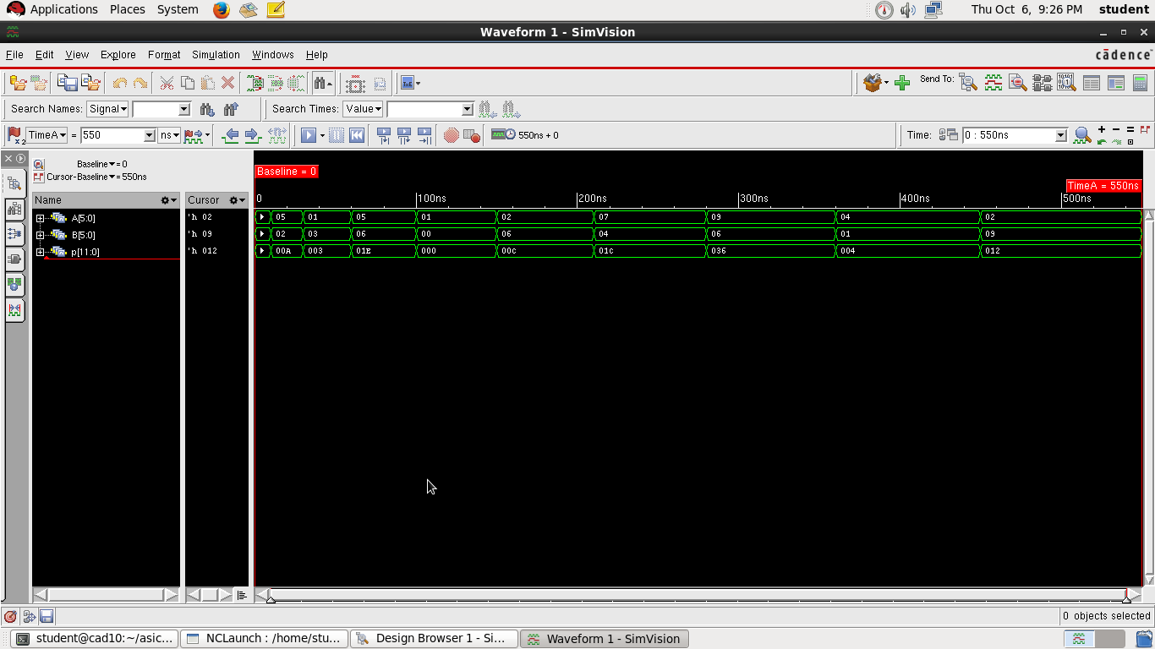
PROOF…,

Slide 24
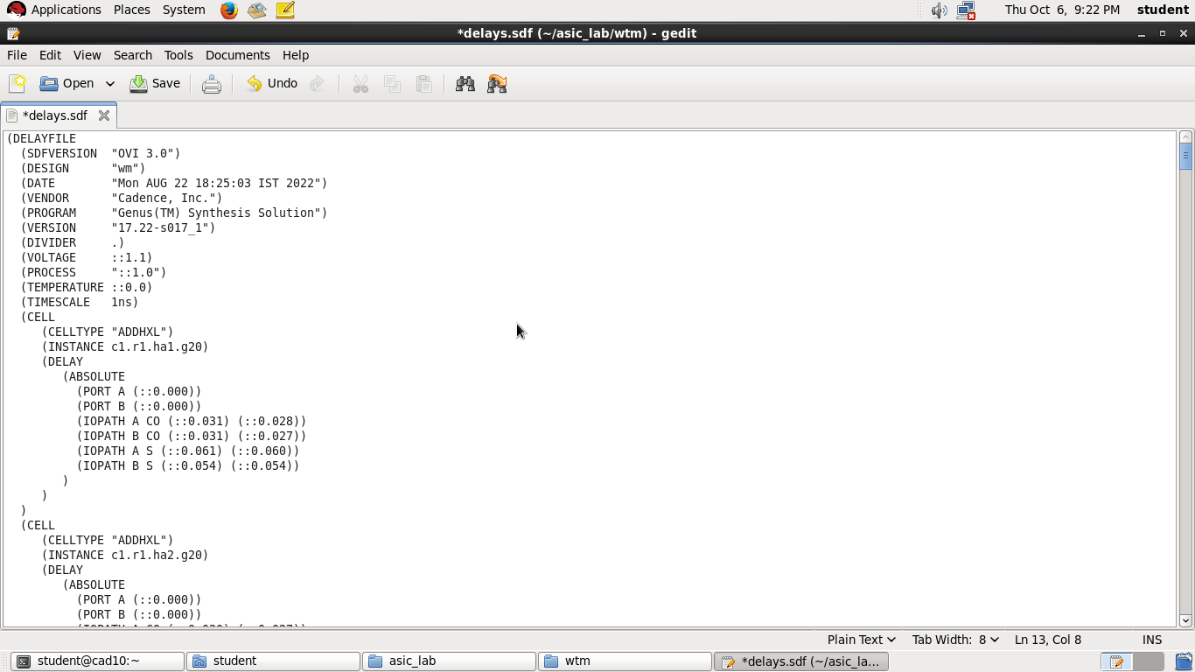

Slide 25
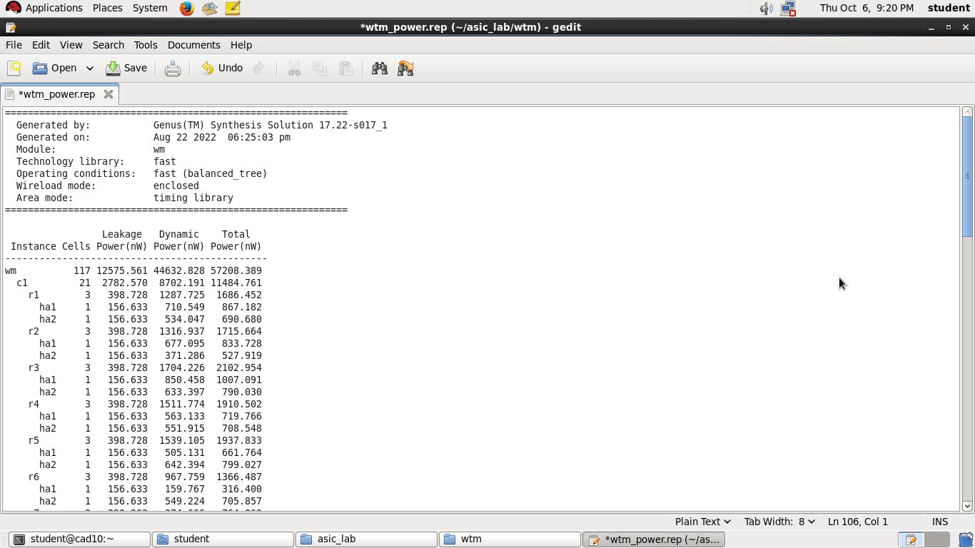

Slide 26


